Slide 1
Here lies Northampton Castle
The Friends of Northampton Castle
Aiming for Northampton’s past to play a part in our future
Notes:
Themes covered in this presentation
Archaeology
Civic Pride
Culture
Geography – urban, topography
Heritage
History – local, social, economic

Slide 2
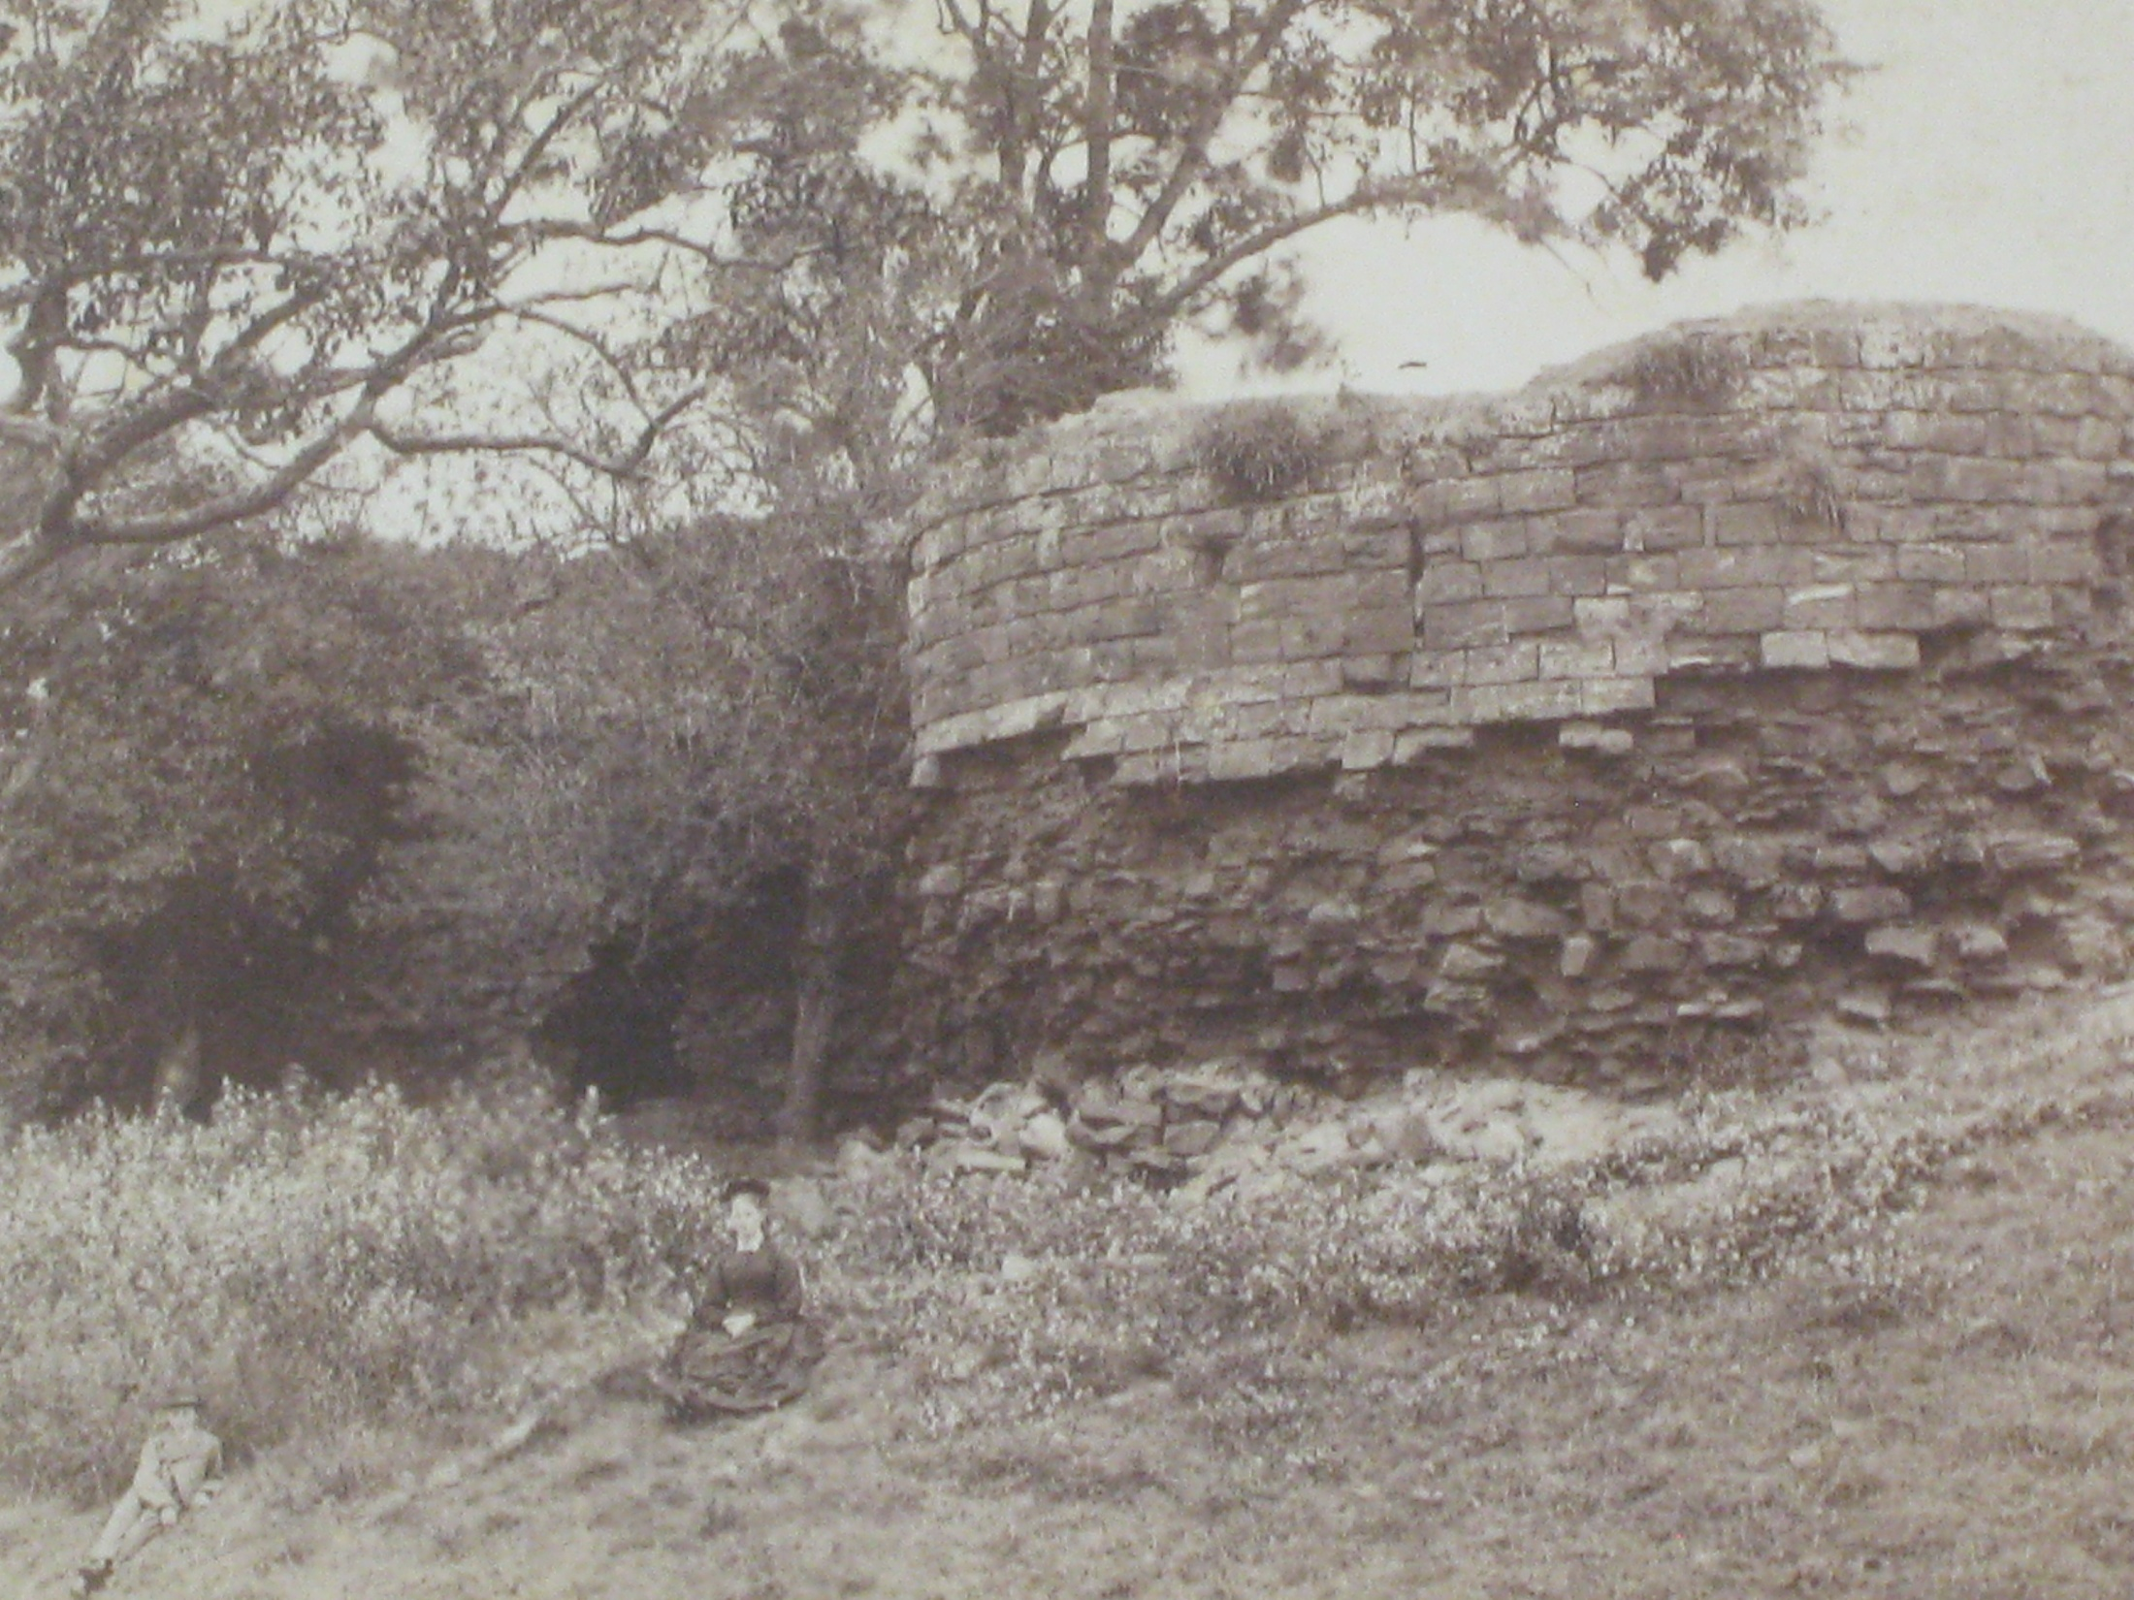
Notes:
Northampton Castle - in Victorian Times
A popular response by people who know that Northampton once had a castle is usually something like:
‘…..Well it was all destroyed when they built the railway….. only the Postern gate remains……’

Slide 3
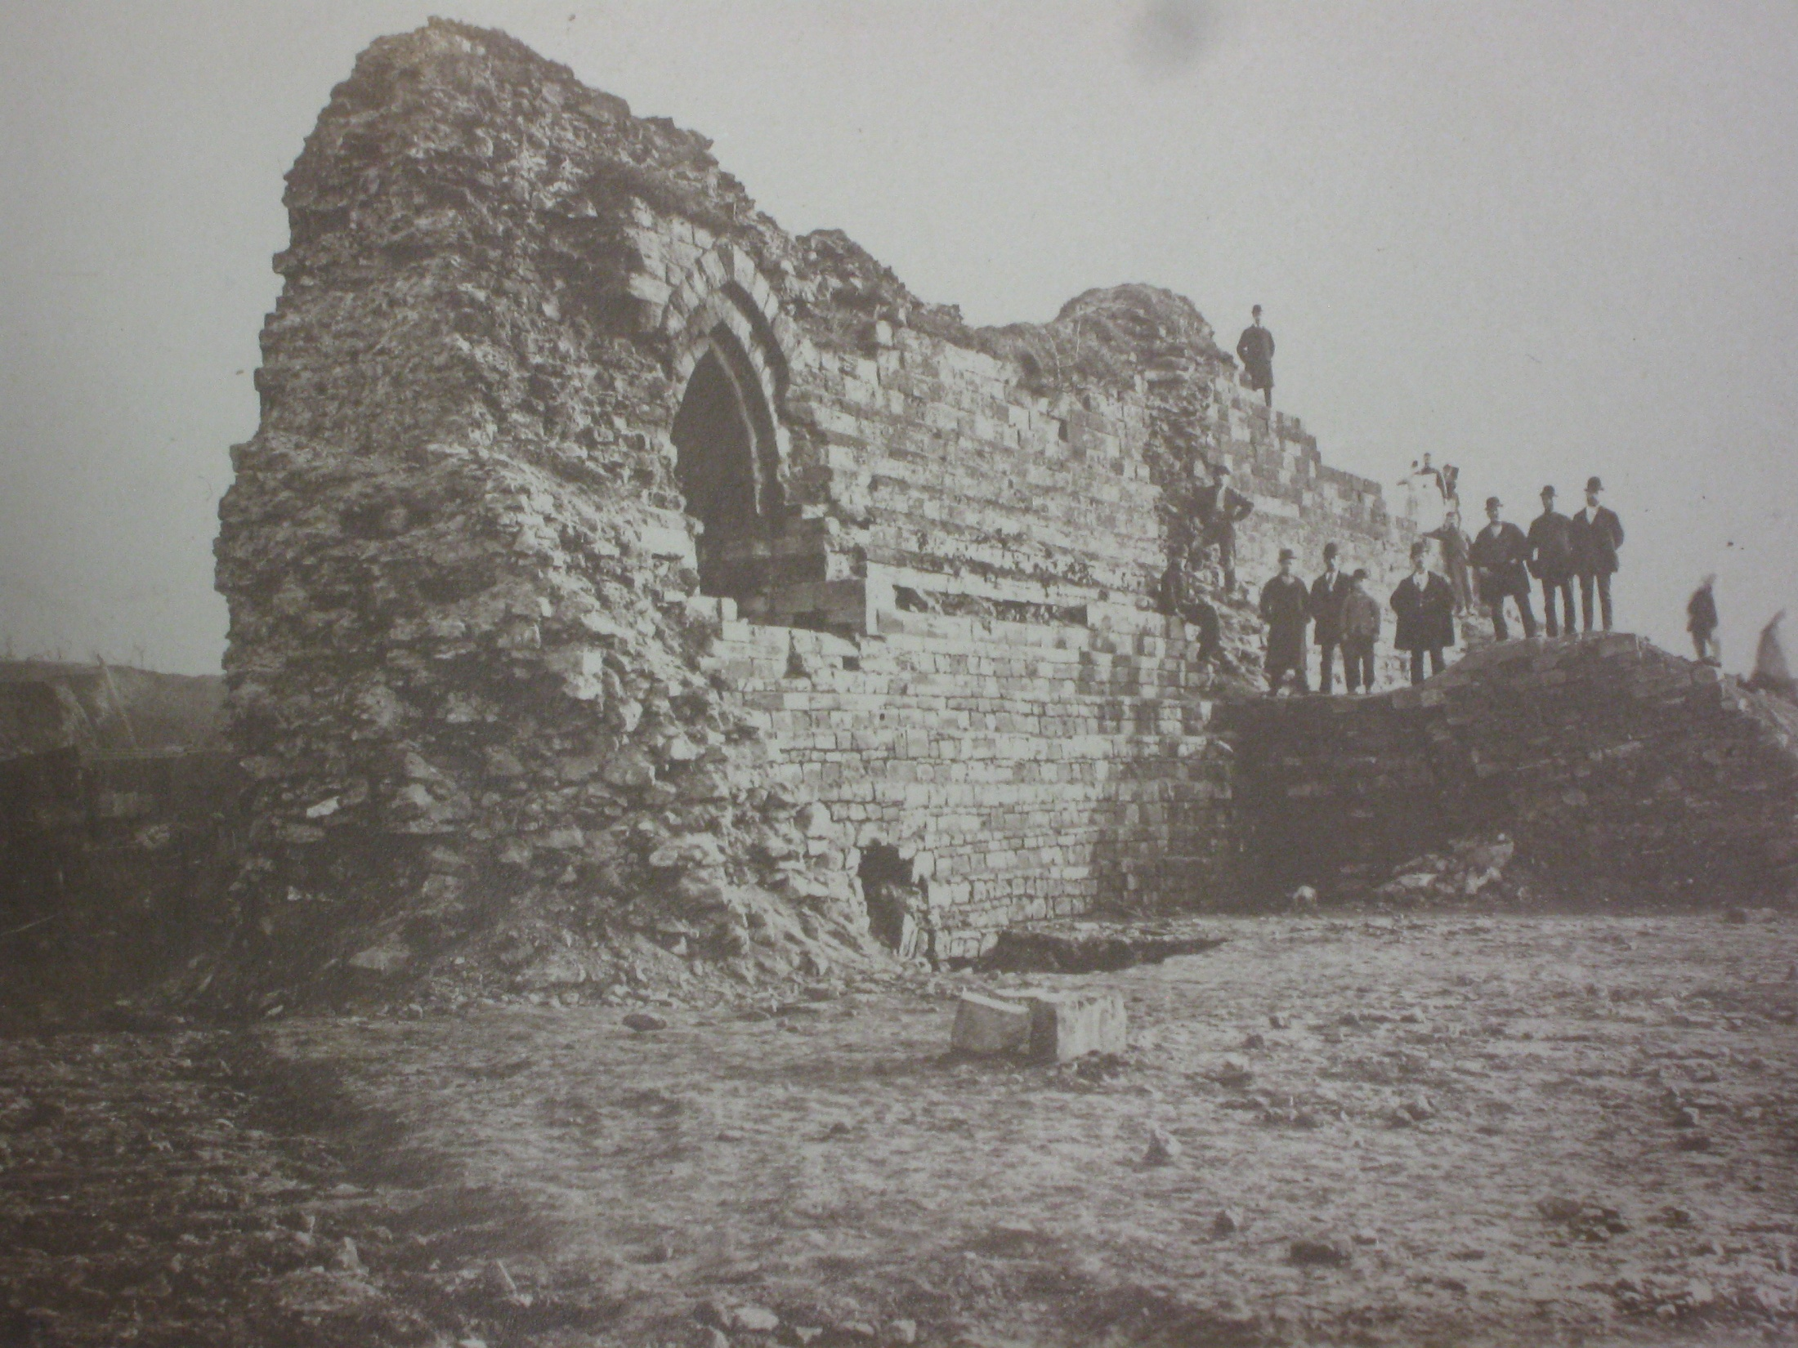
The Postern Gate
During demolition
and
How it looks now
Notes:
Demolished in the 1870’s and rebuilt not exactly…
… more reinterpreted…..
near the entrance to the railway station.
However,
There are more remains of the castle …….
just come this way……

Slide 4
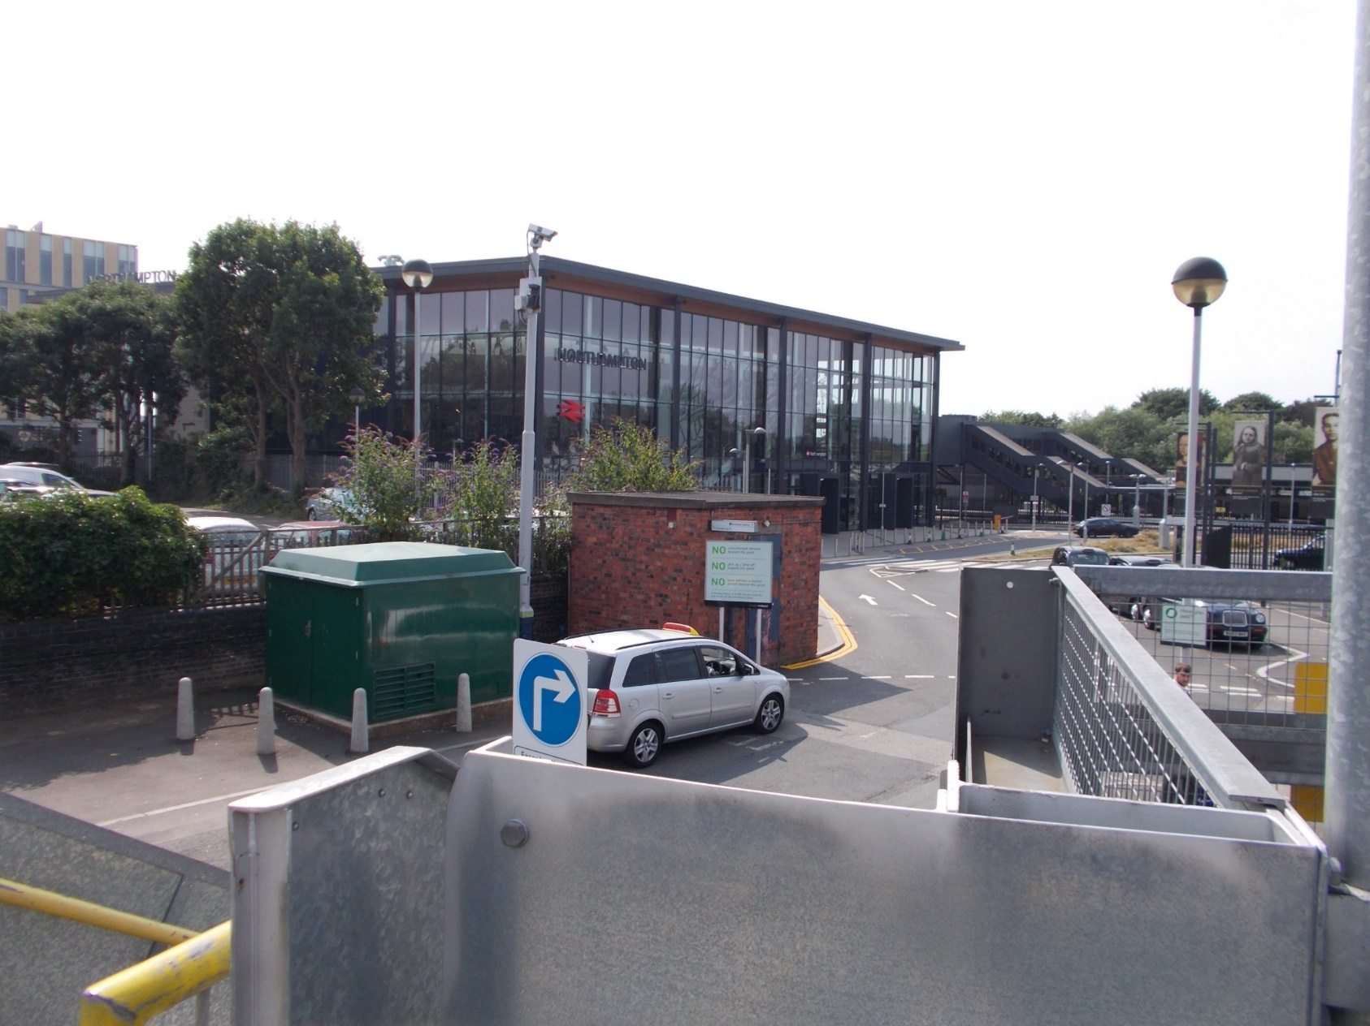
Notes:
The railway station carpark
If you walk up the steps to the raised tier of parking….
You can see this view facing west.
Turn around and you can see…………..

Slide 5
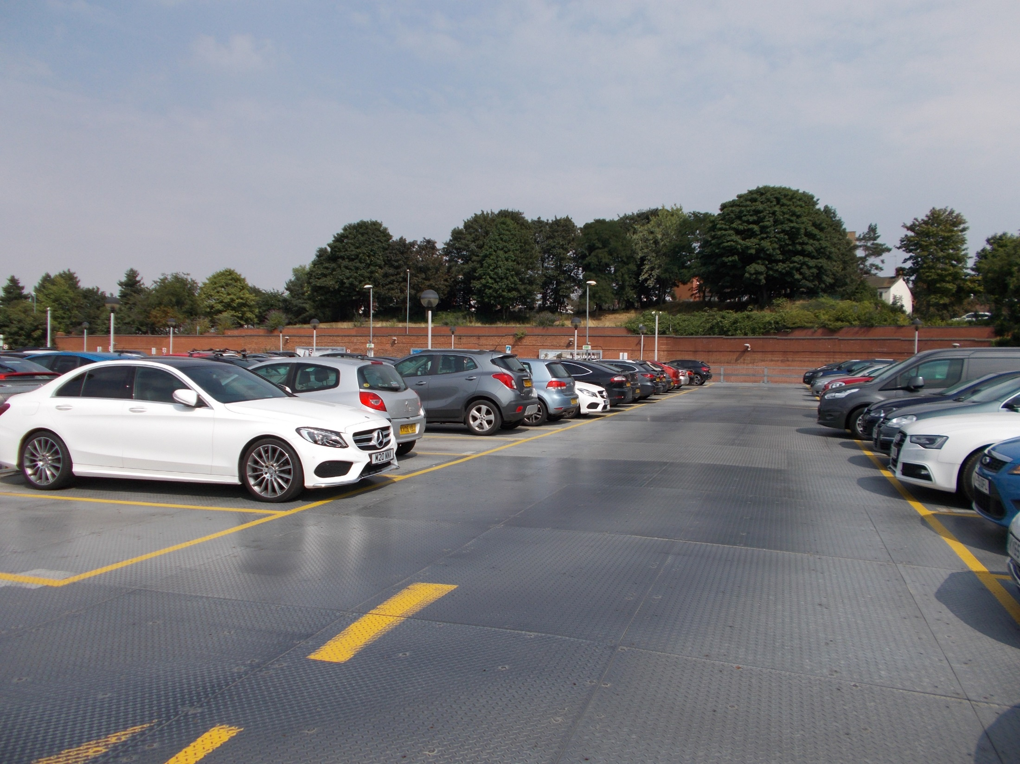
View from raised tier of railway station carpark – looking eastwards
Notes:
….this view.
Look up beyond the cars to the trees and grass bank…..
There lie remains of Northampton Castle.
So lets go there……….

Slide 6
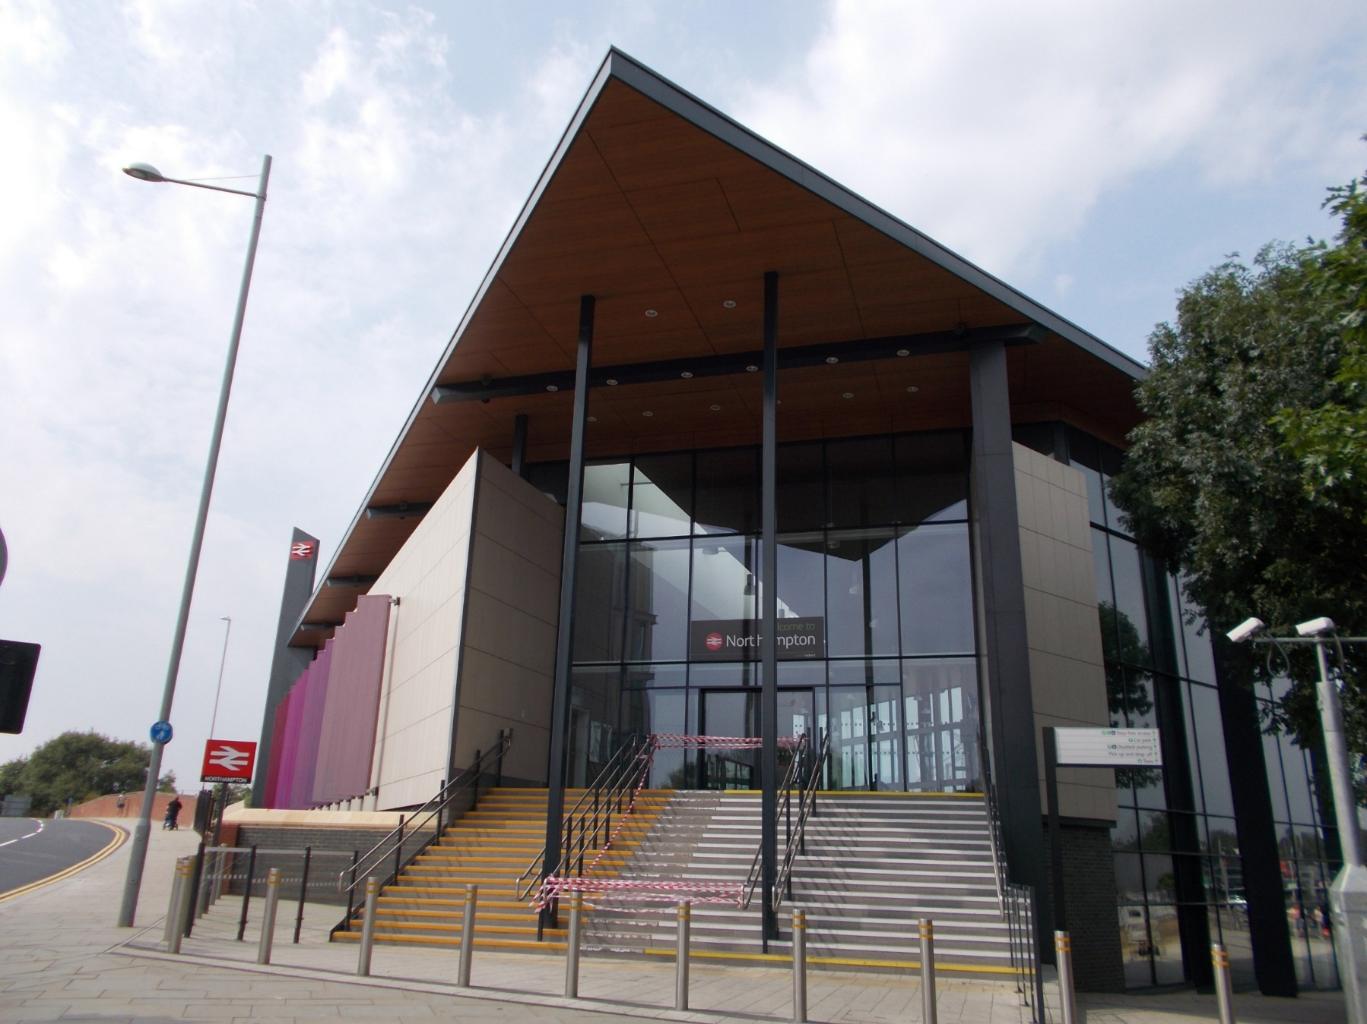
Notes:
Starting at the front entrance of the railway station,
walk towards the town centre…….

Slide 7
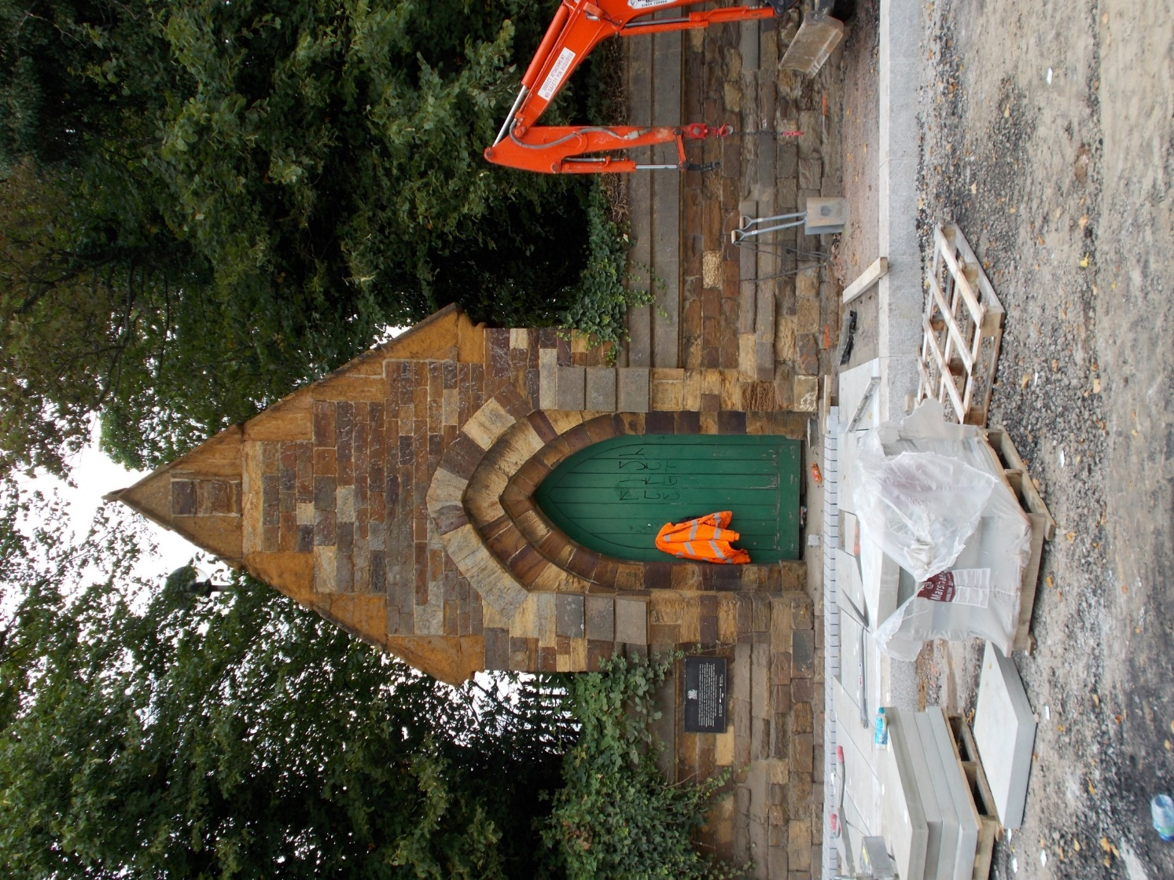
Notes:
Pause at the postern gate.
Hopefully, looking in a more respectful state than this picture shows.
Read the sign.
Look at the brickwork.
Imagine the rich colour of the mighty Castle walls.
Continue on and cross St. Andrew’s road,
taking care by using the traffic crossing system.......

Slide 8
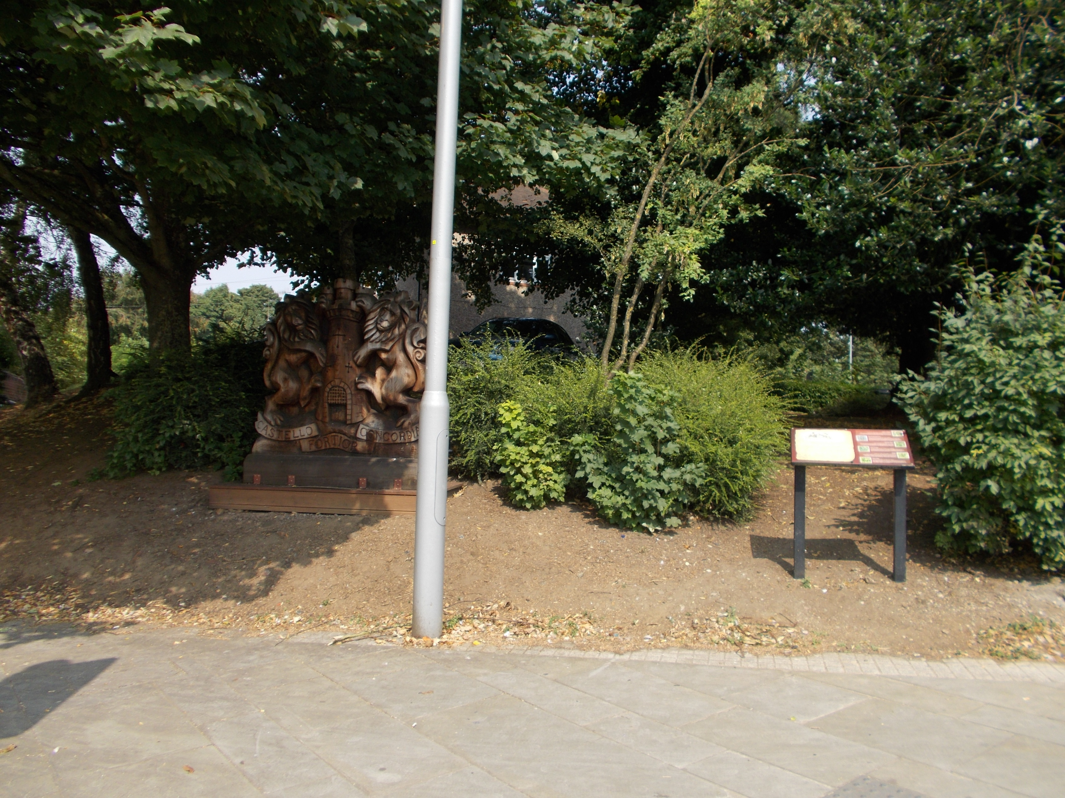
Notes:
On the other side of the road pause to…..
Read the information board about the castle.
and
Look at the wooden statue of the Town Crest (Arms of Northampton).
It depicts a castle keep with portcullis raised on a mound supported by a lion on either side.
The two English lions represent a Royal Castle.
It includes the town motto :-
‘Castello Fortior Concordia’ (Peace is stronger than a fortress.)
It combines royal and local emblems.
Then……

Slide 9
Notes:
Walk up the hill and you will see …….
The first of a number of wooden knights….
…. guarding the castle maybe?

Slide 10
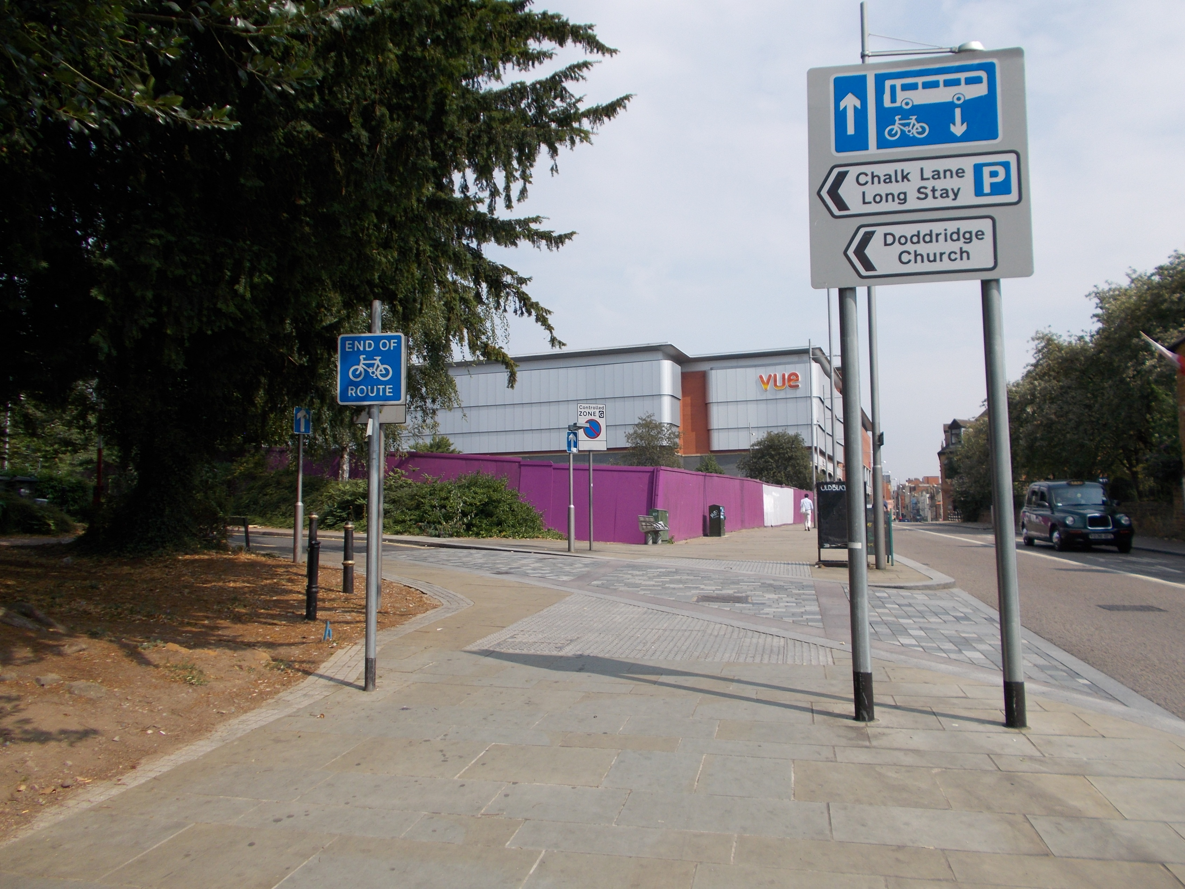
Notes:
Turn left up Chalk Lane.
The curve of the road follows the outside of the castle’s south outer bailey wall.
Then walk passed another knight.
And into…………

Slide 11
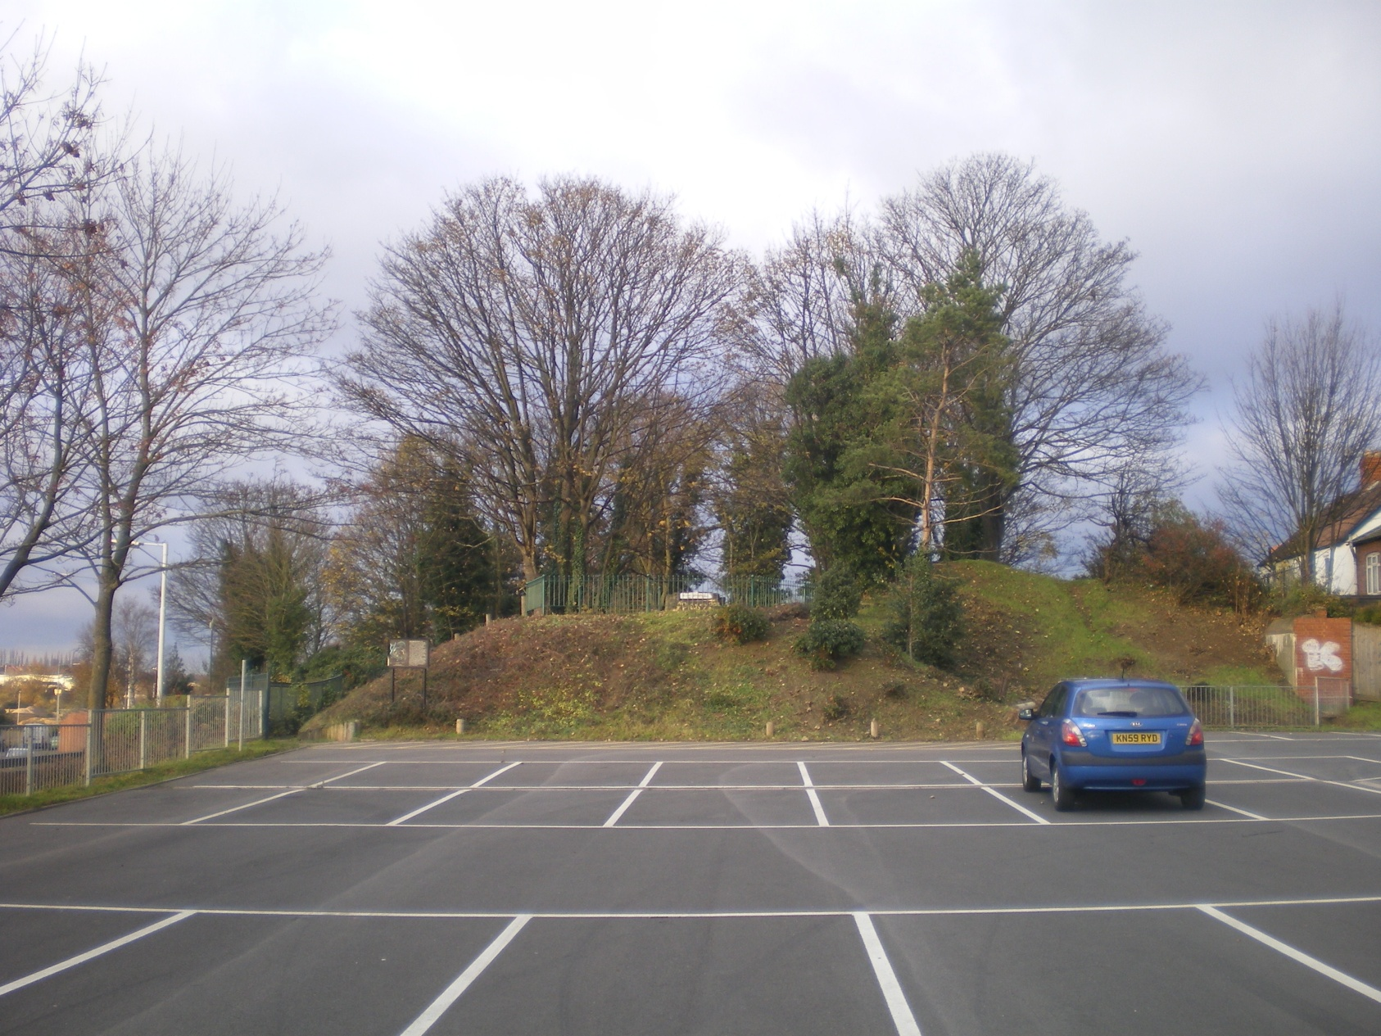
Chalk Lane carpark – looking northwards
Notes:
….Chalk Lane carpark.
Before this carpark was laid in the 1970’s, archaeologists uncovered evidence of Medieval and even earlier Saxon activity.
Carry on to the far side and you will see…..

Slide 12
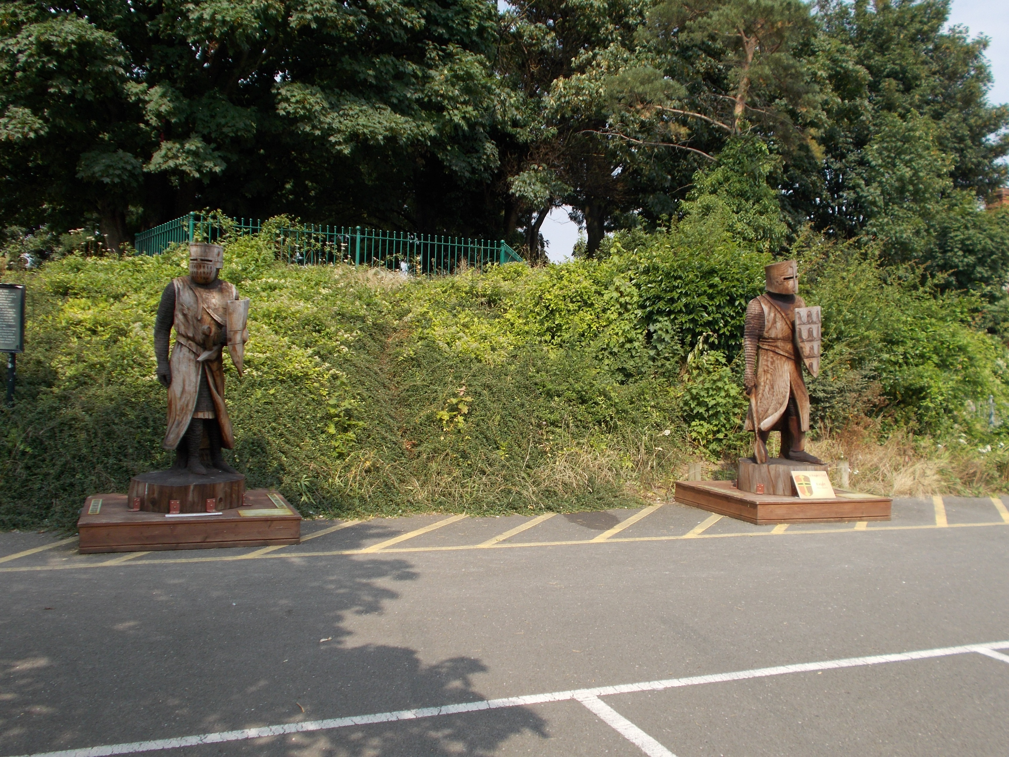
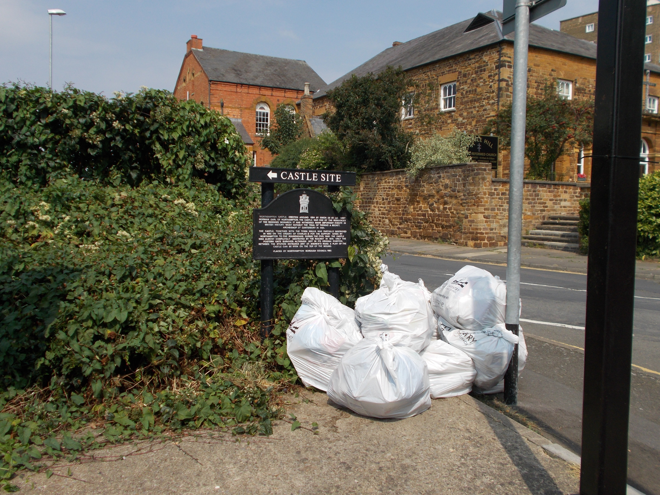
Notes:
More knights ….
and
……….. A sign pointing to the entrance of the Castle Site.
Before you enter the grassy mound……
Look across at the view on your left….

Slide 13
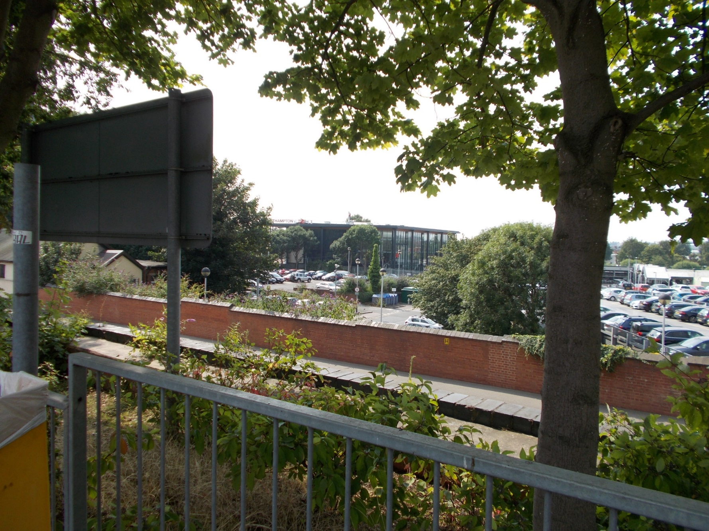
Notes:
…..See how high up you have climbed from the railway station.
And then….
Go into the grassy area and walk up the stepped path on your right and look across at the same view …..

Slide 14
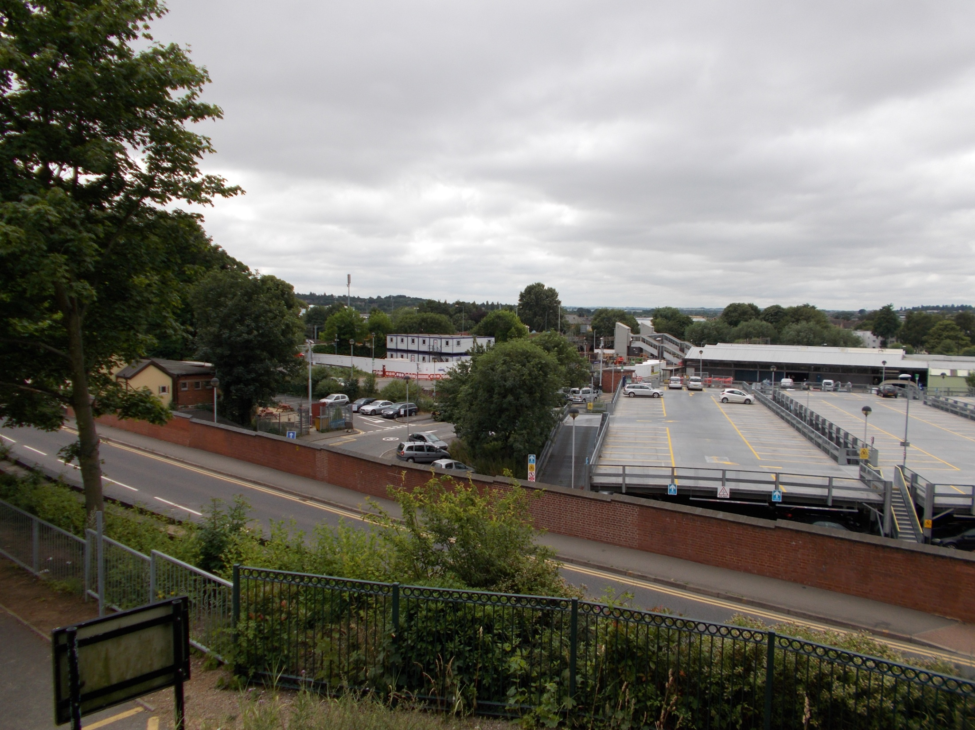
Notes:
This photo was taken before the new station was built.
How far you can see across to the west?
Imagine….
Standing even higher in the Medieval castle.
How far a castle sentry could have seen…
…...on a clear day across to Daventry?

Slide 15
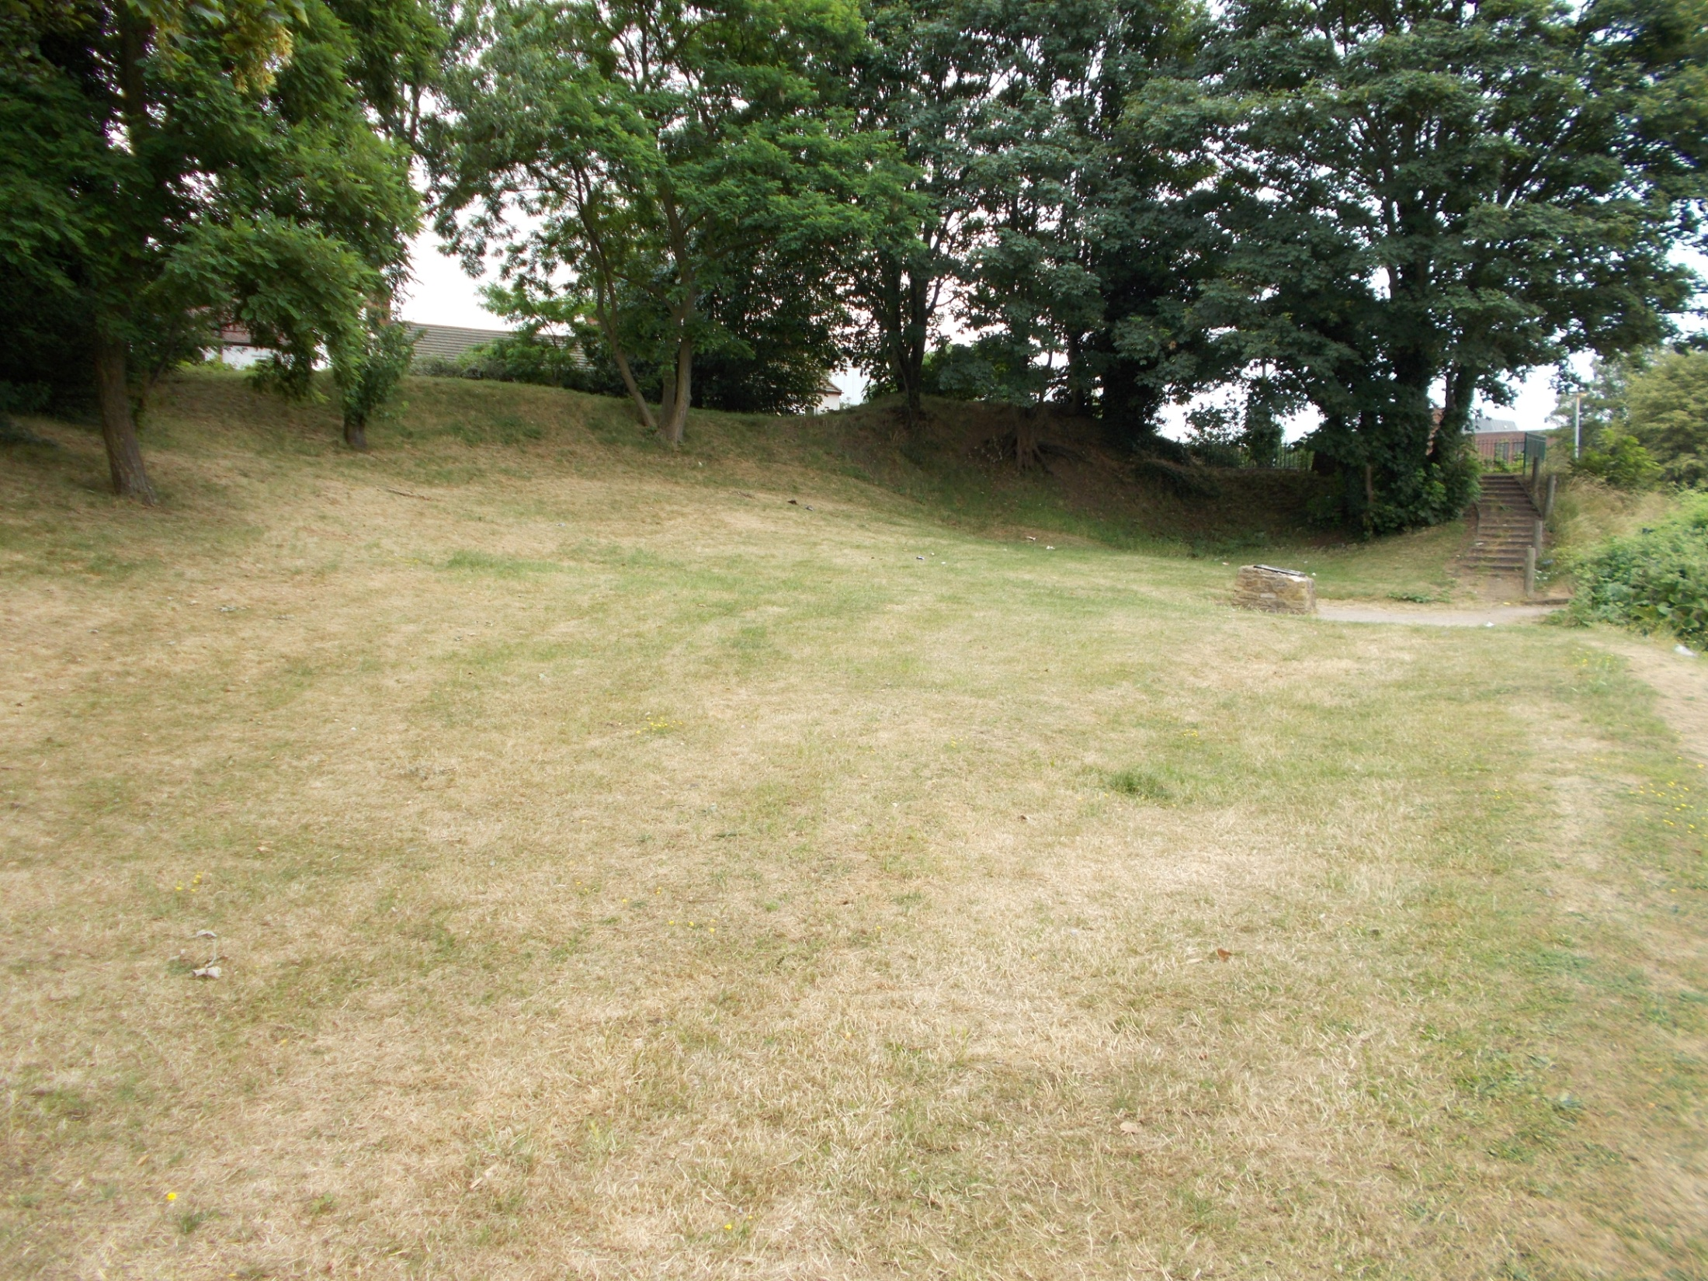
Notes:
Walk down to the middle of the grassy area………
………you are standing on castle remains.
Archaeological investigation has dispelled the belief that the Postern Gate is the only surviving part of Northampton Castle.
During the 1960/70s, excavations in this grassy area alongside St. Andrew’s road they uncovered the remains of one end of the Great Hall where Thomas Becket was tried.
Evidence was also found of the Queen’s chamber and chapel,
and
the kitchens,
also
a garderobe pit (a toilet in a medieval building).

Slide 16
Notes:
'You can read more about the historical significance of this site
on the two new information plaques installed on Castle Mound
during a Medieval Fanfare Celebration in April 2018.'

Slide 17
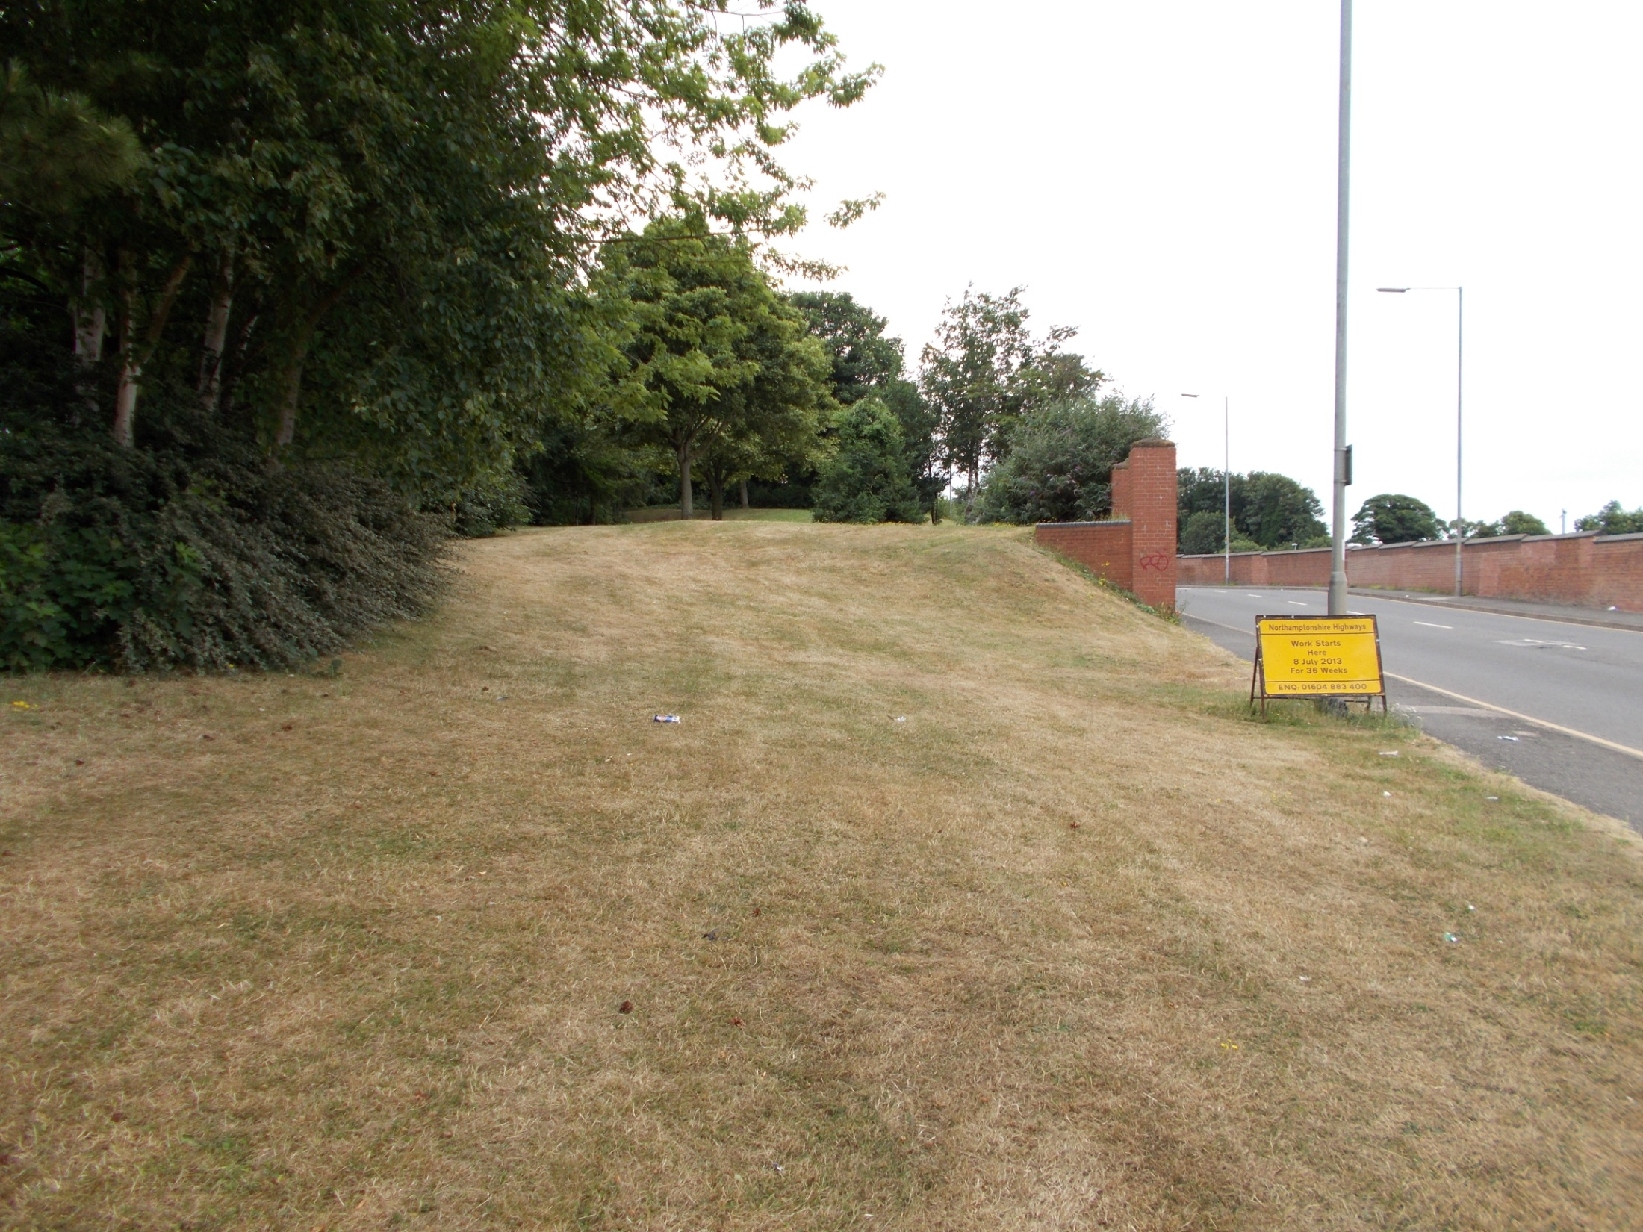
Notes:
Walk on down the grassy mound and turn round….
You are standing near the main entrance to the castle….
….its north gate.
Recognise this area?
How often have you driven along St. Andrew’s road,
or
come out of the railway station carpark and turned right,
and
not realised the significance of this ‘patch’ of land?
Here lies Northampton Castle.

Slide 18
Friends of Northampton Castle (FONC)
www.northamptoncastle.com
Notes:
Why not…
Go to the railway station and take time to look at all the references to the castle and read the information boards.
Look across the station carpark and see the difference in height up to the grassy mound and be amazed at Victorian engineering in clearing the ground.
Walk the route from the railway station to the grassy mound and envisage the scale of the medieval castle.
Think about how the town’s ‘best kept secret’ is celebrated and protected.
The Friends of Northampton Castle thank you for your interest.

